Slide 1




Slide 2

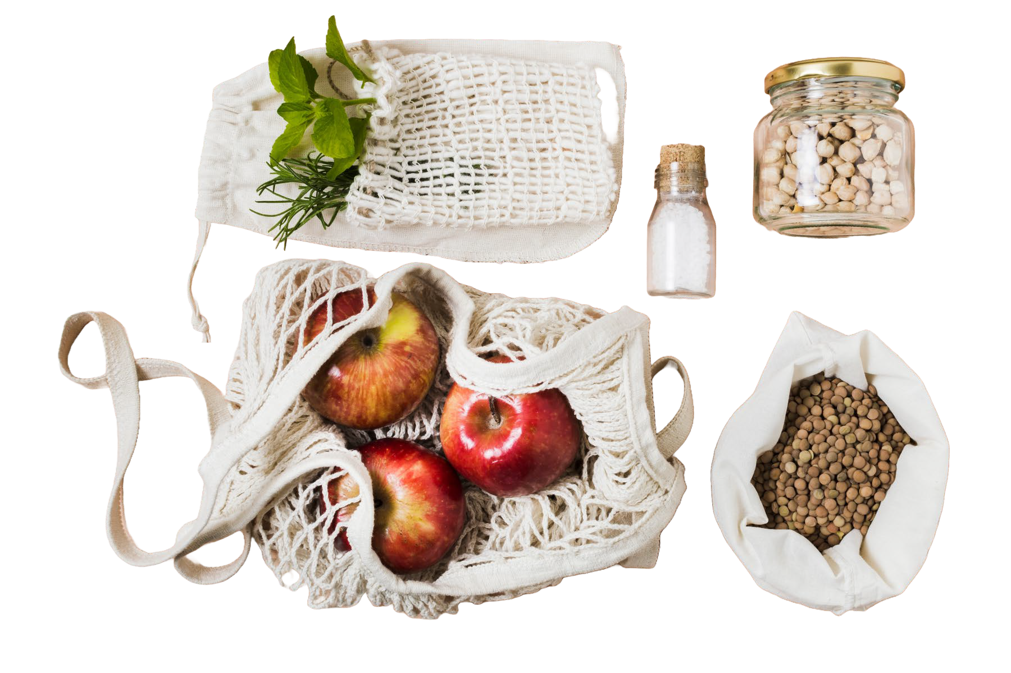
Zero Waste challenge:
Identify soon expired items
Find ways to redistribute these items
Utilize excess inventory
Reduce the need for disposal and the associated environment impacts

Slide 3


G
Letter G as in Get Goodies
Clock and the time that is expiring
Recycling

Slide 4
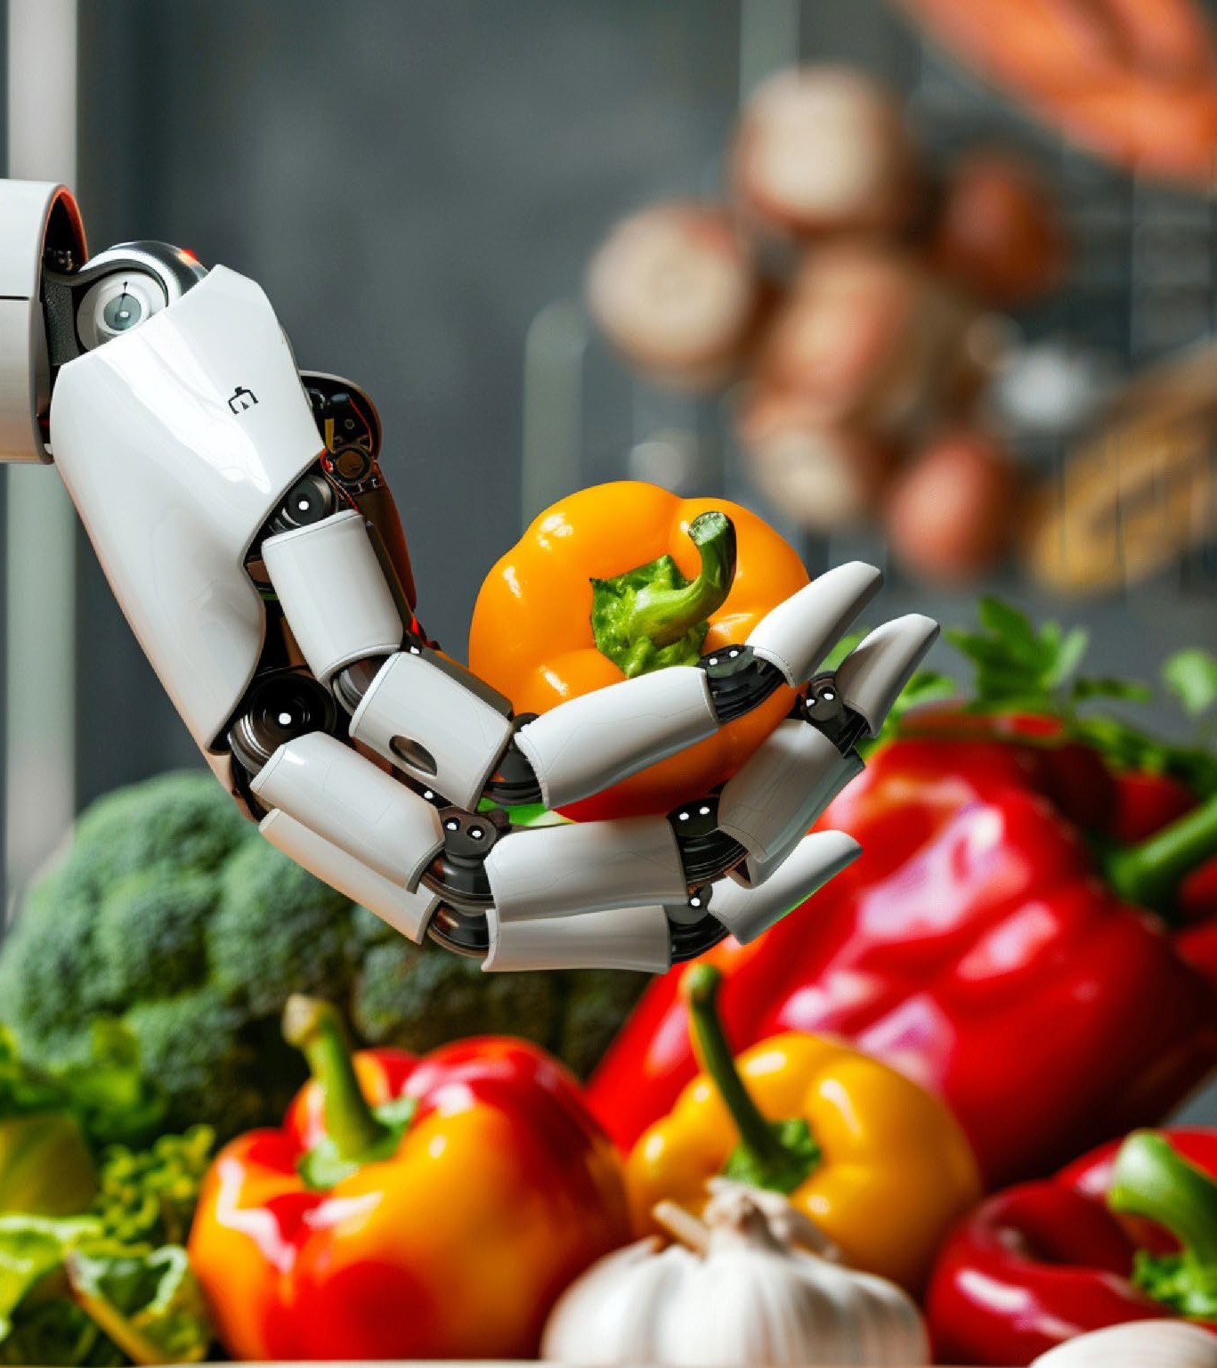




How do we reduce waste?
Ranking system for Goodies
Simulate Goodies go-to market strategies
Promotions based on feedback from customers
Have a chat with the Goodies AI

Slide 5

Last Call Goodies
Theme Goodies
Chat with AI
Create Different Goodies
Redistribute Items Utilize Excess
Identify Expired Items
Weekly Goodies
Event Goodies

Slide 6
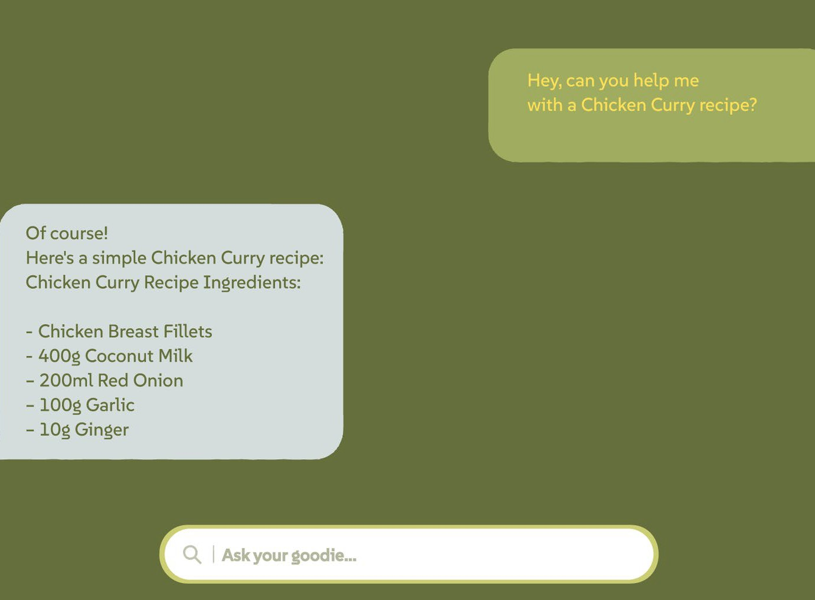
Chat with AI for Preferences

Slide 7
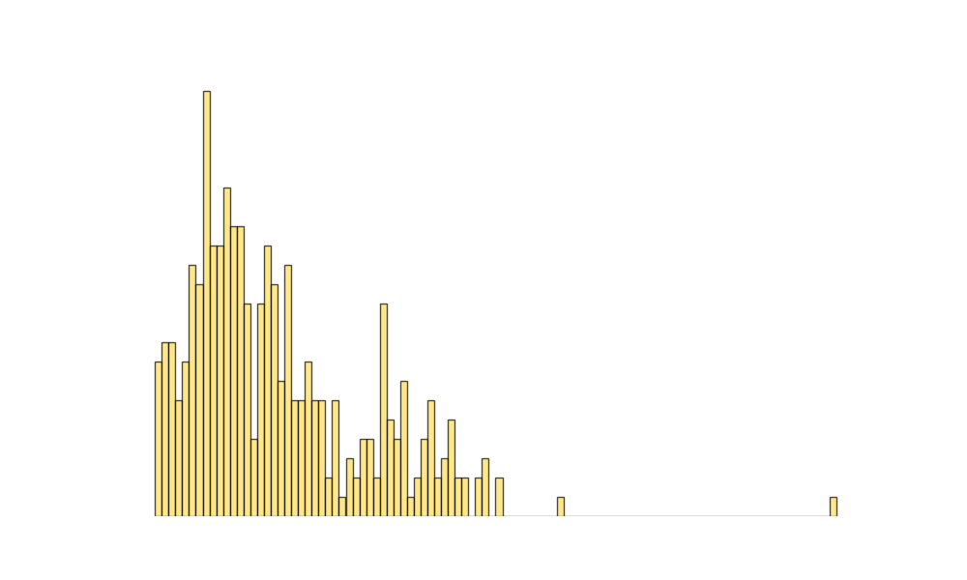
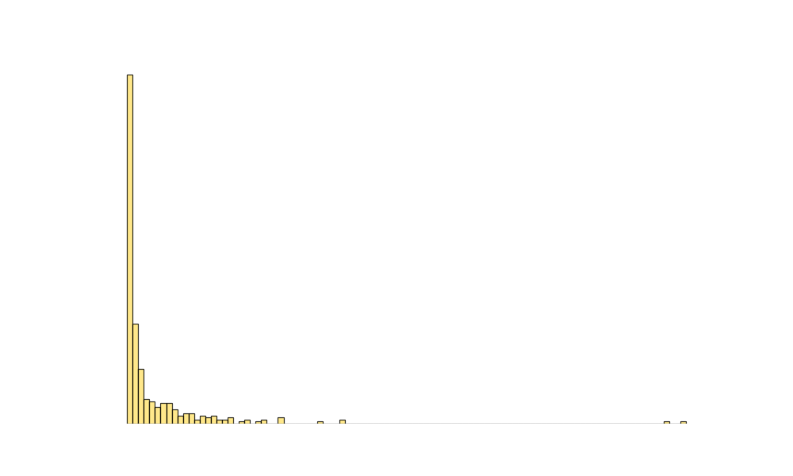
Identify Soon Expired Items
Use a score system with these 3 data we have from the products:
Expiration date - 10 points
Availability - 7 points
Weight - 5 points
Start Discounts from 25% up to 75%
Create alerts for prices for favorite products when reach prices
Algorithm 1
Algorithm 2
Higher Rank Increases Chance of Being a Goodie

Slide 8
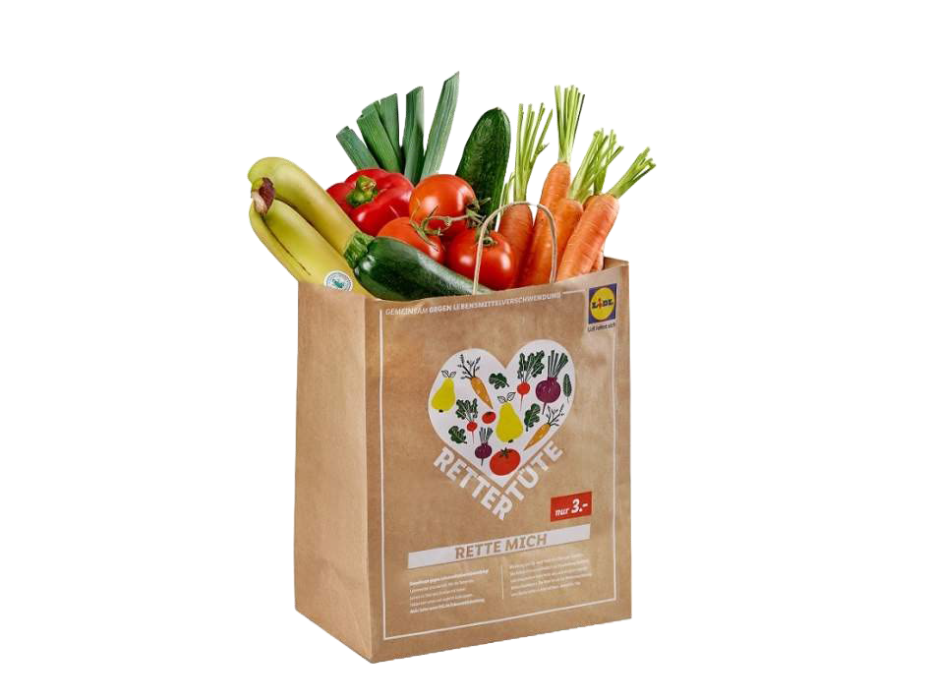
Lidl creates menus based on the top scoring expiring items
Weekly Goodies
Stress free menus for everyday cooking
Bundles:
Based on the “Rettertüte” (rescue bag)
“Ohne Stress Menu”
(No stress menu)

Slide 9
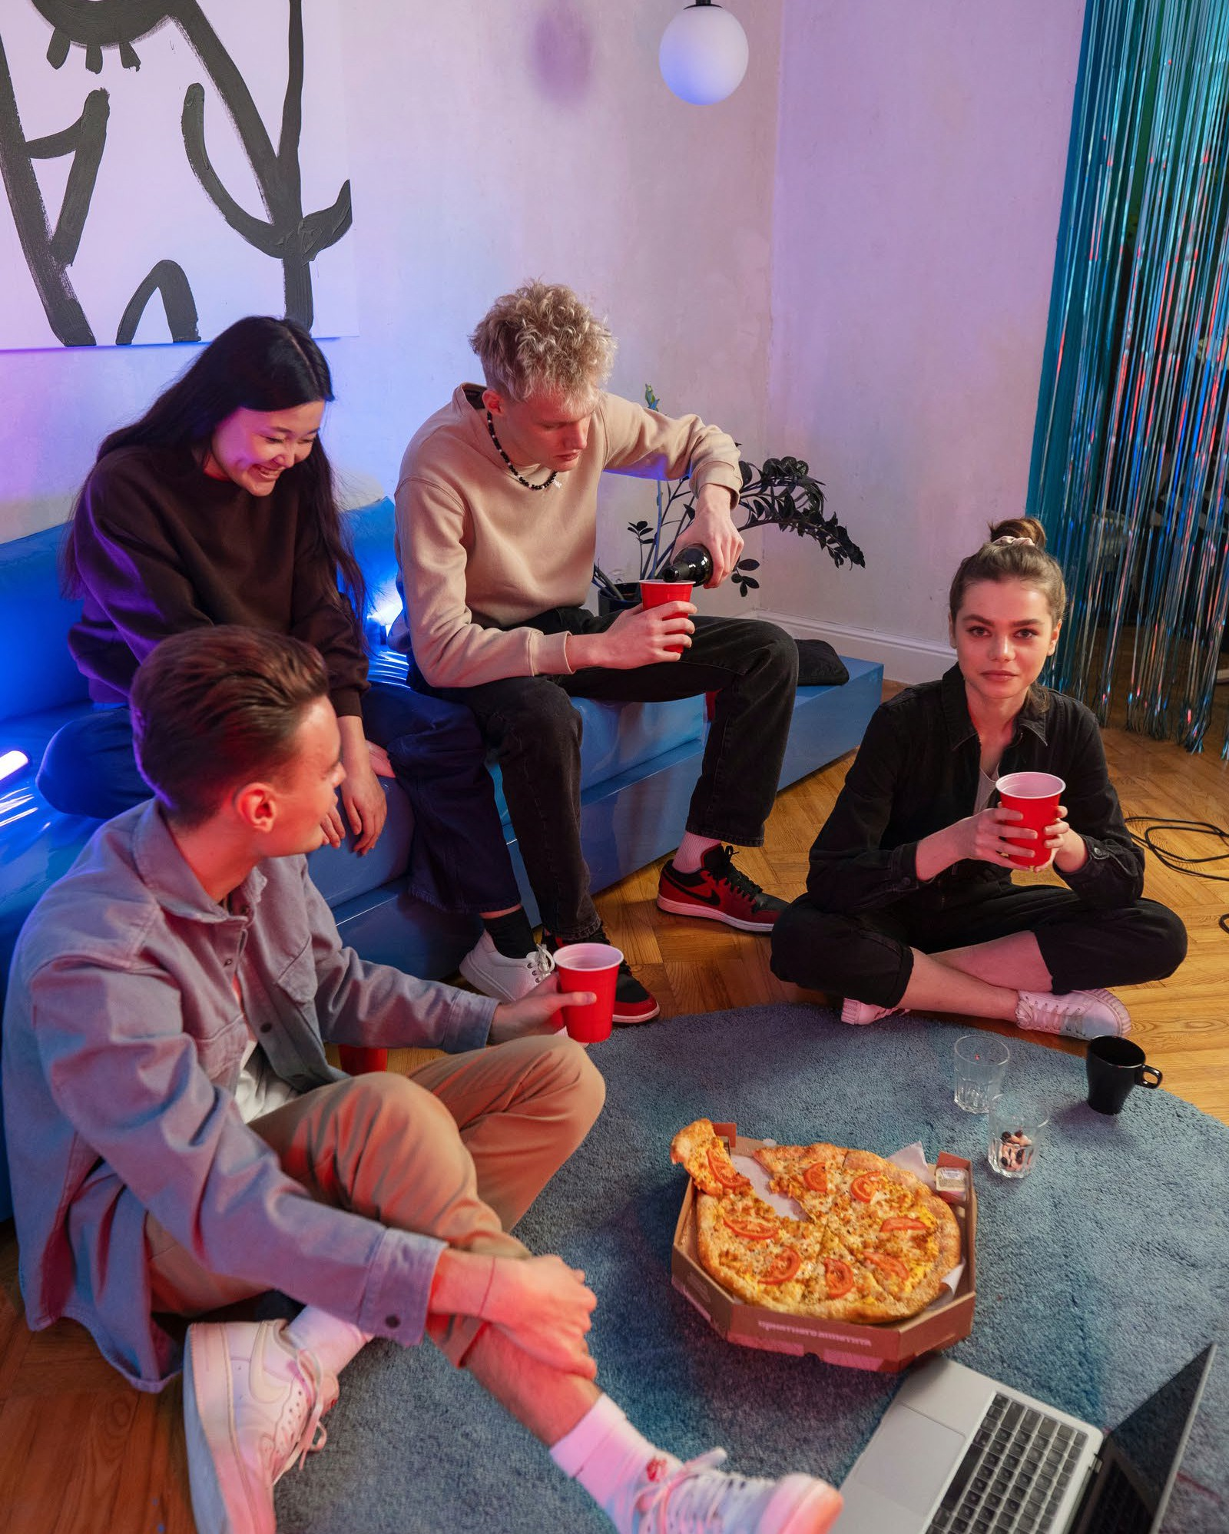
Theme Goodies
Get themed food for your special nights
Movie nights, Valentines, Gaming nights, Coding nights, Party night, Camping, BBQ, Road trip,
And many more!
Based on current emotions: Pick-me -up Packages

Slide 10
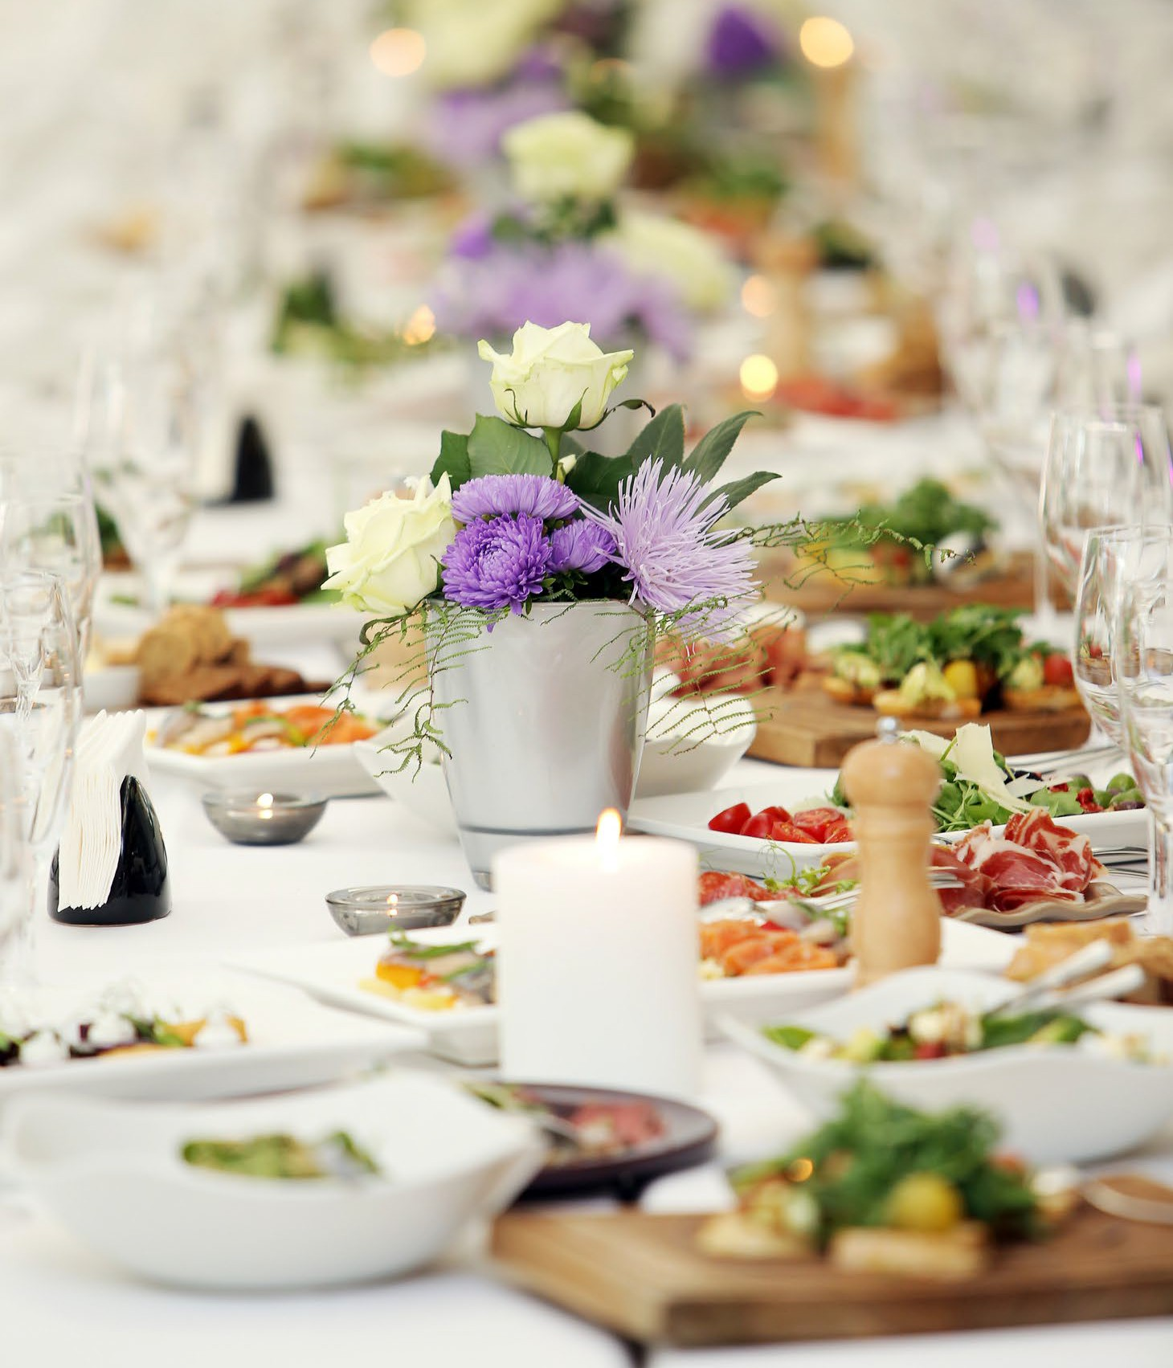
Event Goodies
“Bulk buy for your BIG events”
Festivals Weddings Concerts Business Events
Large orders to fix inventory challenges

Slide 11
Reduce the need for disposal
Food preservation methods and promoting sustainable practices
Fermenting, drying and selling the tools to promote pickling Freezing fruits that are too plenty during season

Slide 12
Regular products
Spend 100 EUR on Lidl shop > Get 10 EUR free on Get Goodies
Win - Win situation
Soon to expire / Get goodies
Spend EUR on Get Goodies, get points
for future purchases or packages with food.

Slide 13
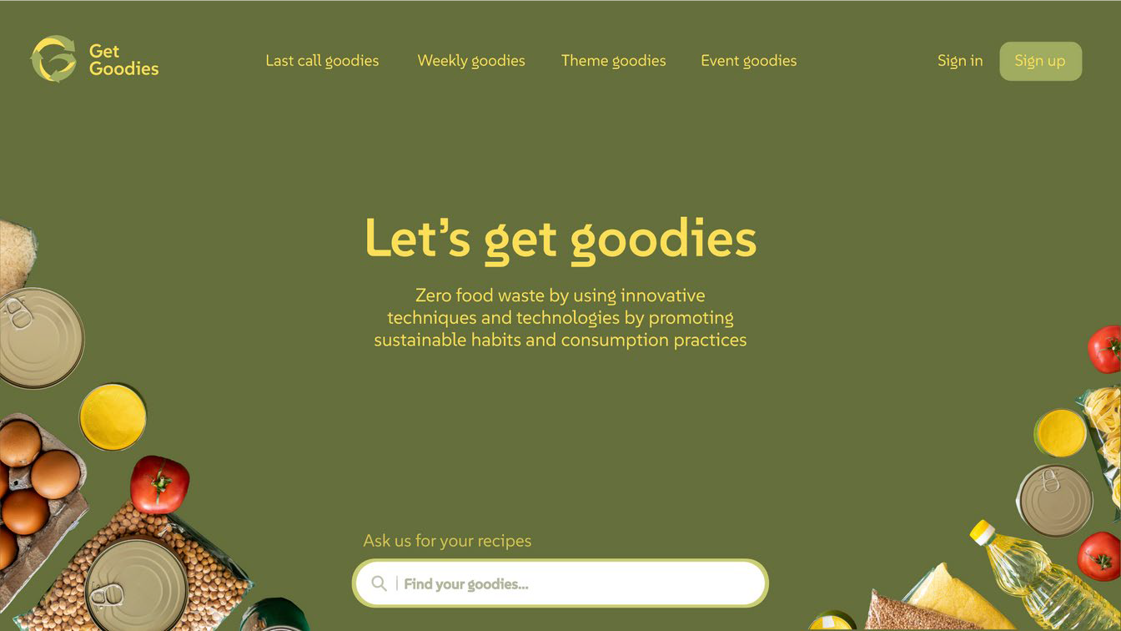
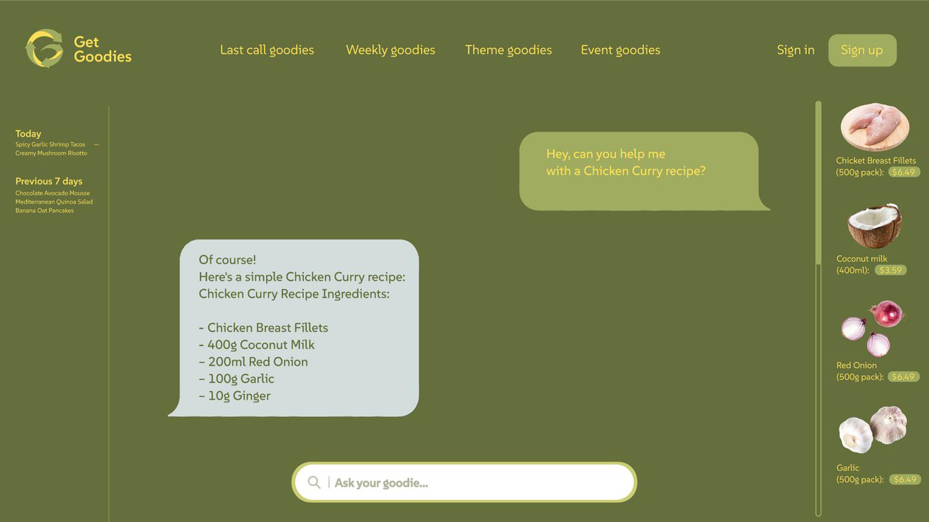
UI/UX

Slide 14







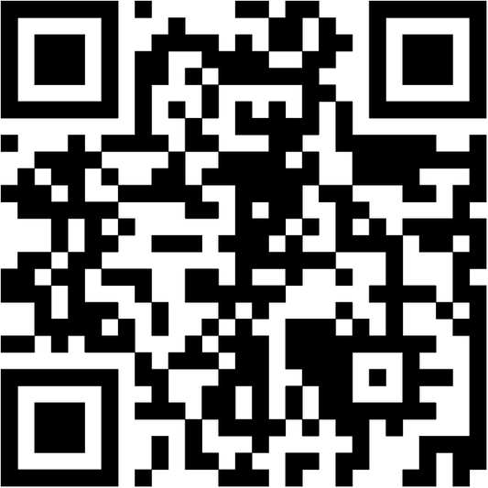
What We Explored?
Fullstack
Monidas Platform
Pair programming + instant deployment
LAN JAM (Linux + Apache + Node + JS + API/AI + Markup)
AI
Custom LLMs
Azure AI Search
Azure AI RAG (Retrieval Augmented Generation)
Visit Goodies @ https://app.sc.hack.monidas.com/apps/gg/#
Code: https://github.com/ColombaLink/hackathon_mannheim_2024/

Slide 15
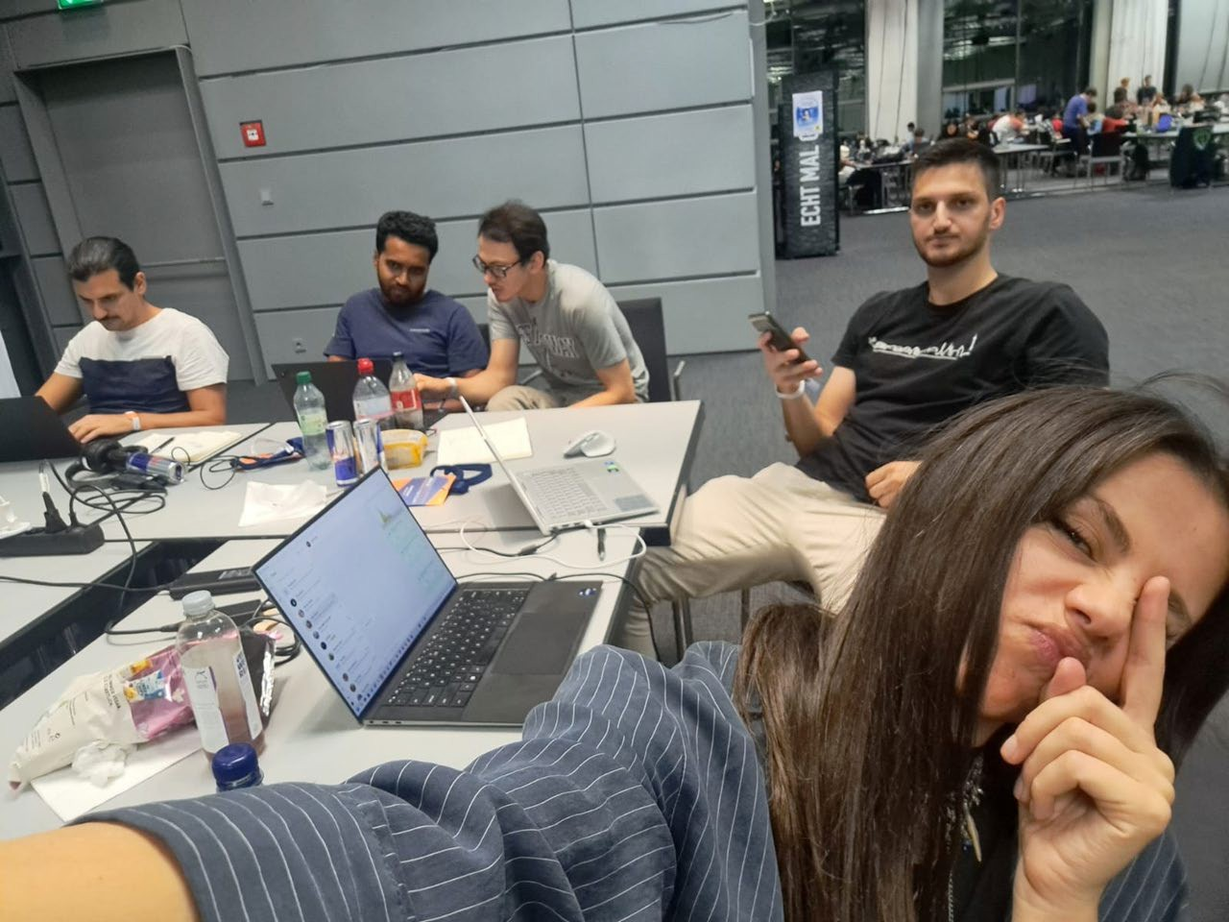


Meet the Team
Fabrzio Parrillo Niluka Piyasinghe Normand Overney Genti Zarari
Anyla Musa
Thank You:

